Slide 1
Abstract
Learning mathematics and numeracy involves students making connections between ideas for themselves.

Slide 2
Overall goals of the curriculum
development of expert mathematicians
expert users of mathematics in the professions
a workforce capable of meeting all numeracy requirements
citizens able to use the mathematics they need

Slide 3
the curriculum is intended to be clear and succinct, and this is about pedagogy
  clarity is needed for interactivity
  not about setting low expectations for teachers
  demands for additional detail should be resisted
Often teachers feel they have to rush from one topic to the next, and this is bad for teaching
  studying combined topics in more depth
  some topics are more important than others

Slide 4
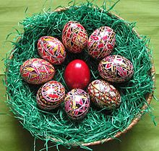
Easter …

Slide 5
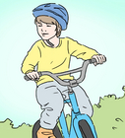
Teaching kids to ride

Slide 6
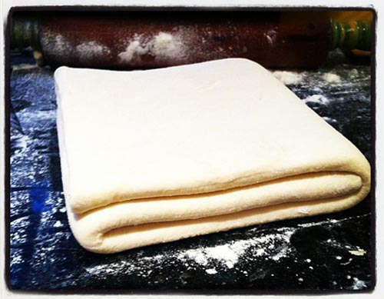

Slide 7
Some aspects of learning mathematics are like hunting for Easter eggs, some aspects are like learning to ride a bike, and some are like learning French

Slide 8
In the Australian curriculum
Understanding
  (connecting, representing, identifying, describing, interpreting, sorting, …)
Fluency
  (calculating, recognising, choosing, recalling, manipulating, …)
Problem solving
  (applying, designing, planning, checking, imagining, …)
Reasoning
  (explaining, justifying, comparing and contrasting, inferring, deducing, proving, …)

Slide 9
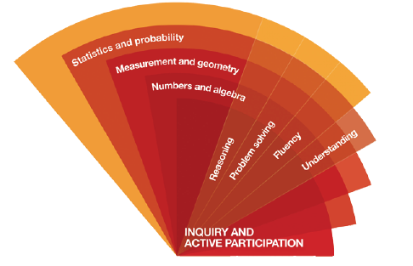
The proficiencies are core components (not add ons)

Slide 10
The proficiencies are core components (not add ons)

Slide 11
There is agreement that tasks are important
“in the mathematics classroom, it is through tasks, more than in any other way, that opportunities to learn are made available to the students” (Anthony & Walshaw, 2009, p.96).

Slide 12
And those tasks should be challenging
Christiansen and Walther (1986) argued that non-routine tasks, because of the interplay between different aspects of learning, provide optimal conditions for cognitive development in which new knowledge is constructed relationally and items of earlier knowledge are recognised and evaluated.

Slide 13
Especially if we wish to go beyond developing fluency …
Kilpatrick et al. (2001)
  teachers who seek to engage students in developing adaptive reasoning and strategic competence (or problem solving) should provide them with tasks that are designed to foster those actions.

Slide 14
… and the tasks can address the goals of the curriculum …
National Council of Teachers of Mathematics (NCTM) (2014) noted:
  Student learning is greatest in classrooms where the tasks consistently encourage high-level student thinking and reasoning and least in classrooms where the tasks are routinely procedural in nature. (p. 17)

Slide 15
Cognitive activation tasks require students (prior to instruction) to
plan their approach, especially sequencing more than one step;
process multiple pieces of information, with an expectation that they make connections between those pieces, and see concepts in new ways;
choose their own strategies, goals, and level of accessing the task;
spend time on the task and record their thinking;
explain their strategies and justify their thinking to the teacher and other students.

Slide 16
Should we start easy and wind it up or start challenging and wind it back?
Students benefit when they move from not knowing how to do something to knowing how to do it.
In other words, what they have learned is explicit to them.
  This does not necessarily happen if they are working on the “known”.
When confronted with a task that they cannot do, students need to explore their existing mental structures and schemes, explore links, build connections and identify aspects that are unknown for themselves.

Slide 17
Getting started
“zone of confusion”
“four before me”
  representing what the task is asking in a different way such as drawing a cartoon or a diagram, rewriting the question …
  choosing a different approach to the task, which includes rereading the question, making a guess at the answer, working backwards …
  asking a peer for a hint on how to get started
  looking at the recent pages in the workbook or textbook for examples.

Slide 18
Assumptions
students are not reasoning if they are merely repeating an argument developed by someone else – the reasoning needs to be their own
Students are not solving problems if they have been told what to do
thinking … takes time and that it happens only when students are working on tasks that they do not know how to solve.

Slide 19

Making comparisons
How can we make the number of cakes on each plate the same?
Give as many possibilities as you can?

Slide 20
What is the mathematics content we hope students will learn?
What are the proficiencies prompted by that task?
In what ways might the “verbs” contribute to the learning of the ”nouns”?

Slide 21
The Foundation level of the AC includes …
Compare, order and make correspondences between collections, initially to 20, and explain reasoning (ACMNA289)

Slide 22
Some aspects of the “lesson”
What would you “tell” the students?

Slide 23
An introduction
Describe what you see

Slide 24
For students who may not be quite ready
How many cakes can you see?

Slide 25
For students who do it readily
How can we make the number of cakes on each plate the same?
Give as many possibilities as you can?

Slide 26
More comparisons

Slide 27
Formalising
9 – 4 = 5
5 + 4 = 9
9 – 2 = 5 + 2
9 – 5 = 5 – 1
9 – 9 + 1 = 5 – 5 + 1

Slide 28
How could we make the containers balance?
(give as many answers as you can)

Slide 29
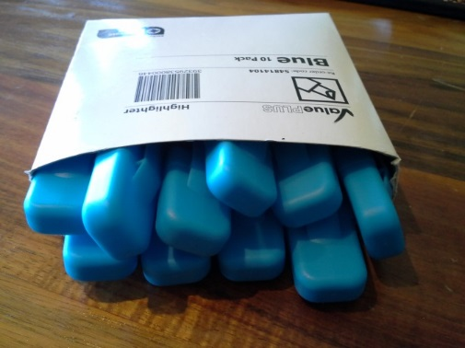
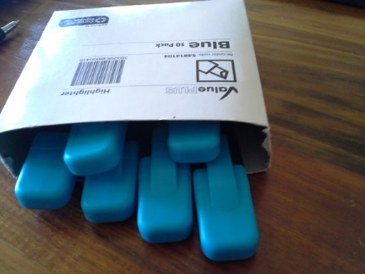
A Consolidating task
How can we make the number of highlighters in each box the same? (Give as many possibilities as you can?

Slide 30
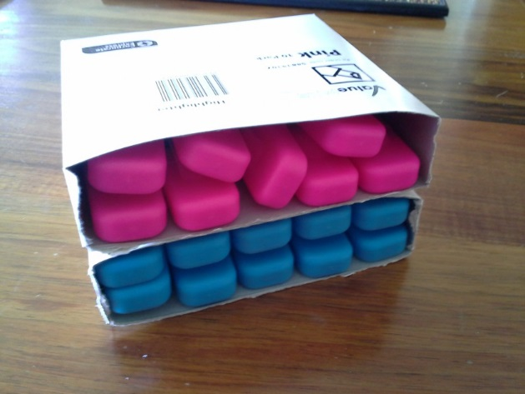
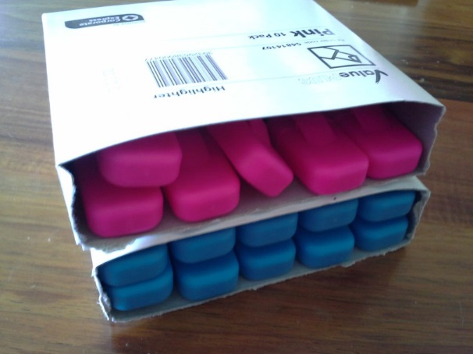
I want to make these two sets of highlighters the same. How can I do that?

Slide 31
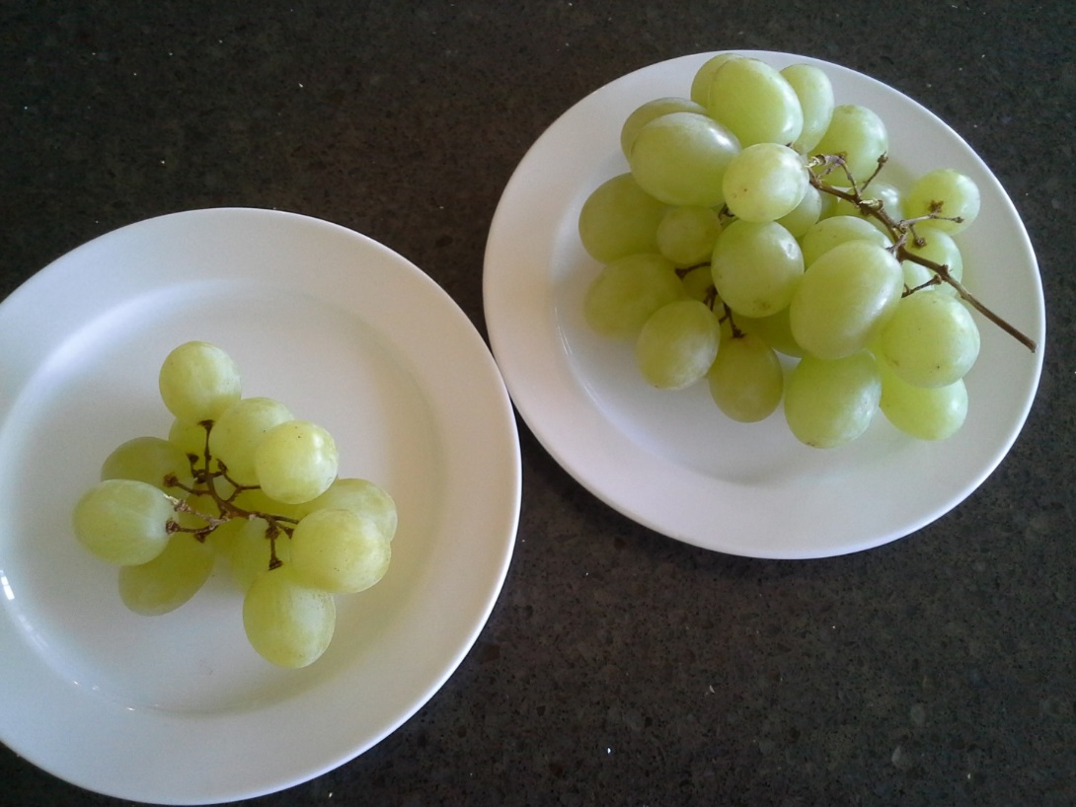
How can we make the number of grapes on each plate the same?

Slide 32
What question are you asking?

Slide 34
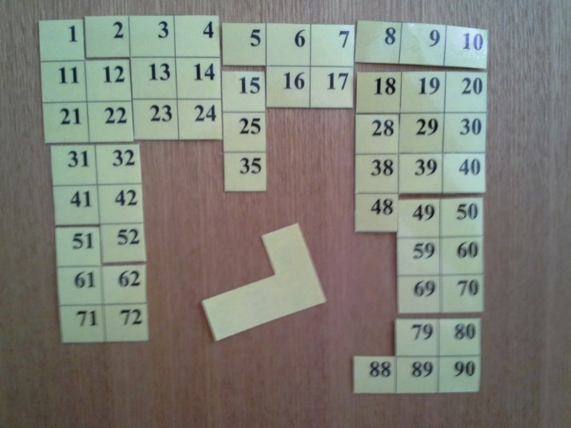
LEARNING TASK
What might be the numbers on the L Shaped piece?
I know that one of the numbers is 65.
Give as many possibilities as you can.

Slide 35
What is the mathematics content we hope students will learn?
What are the proficiencies prompted by that task?
In what ways might the “verbs” contribute to the learning of the nouns?

Slide 36
This lesson addresses the following descriptors from the AC for year 1 (year 2 descriptors are similar, although with numbers to 1000):
Recognise, model, read, write and order numbers to at least 100. Locate these numbers on a number line (ACMNA013)
Represent and solve simple addition and subtraction problems using a range of strategies including counting on, partitioning and rearranging parts (ACMNA015)

Slide 37
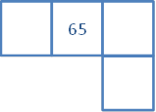
ENABLING PROMPT
What might be the missing numbers on this piece?

Slide 38
EXTENDING PROMPT
Convince me that you have all of the possible combinations.

Slide 39
But that task was to activate cognition. We now need to consolidate the learning.

Slide 40
CONSOLIDATING TASK
The numbers 62 and 84 are on the same jigsaw piece.
Draw what might that piece look like?

Slide 41
SPOT THE MISTAKE
There are some mistakes in this hundreds chart. What are the mistakes? Explain how you found them.

Slide 42
WHAT IS MISSING?
This hundreds chart has not been completed.
Fill in the missing number

Slide 43
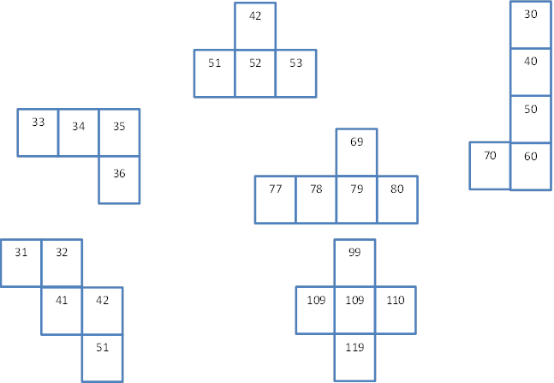
WHAT IS POSSIBLE?
Which of the following jigsaw pieces could be from a 100s chart, and which are not? Explain
your reasoning.

Slide 44
1 | 2 | 3 | 4 | 5 | 6 | 7 | 8 | 9 | 10
11 | 12 | 13 | 14 | 15 | 16 | 17 | 18 | 19 | 20
21 | 22 | 23 | 24 | 25 | 26 | 27 | 28 | 29 | 30
31 | 32 | 33 | 34 | 35 | 36 | 37 | 38 | 39 | 40
41 | 42 | 43 | 44 | 45 | 46 | 47 | 48 | 49 | 50
51 | 52 | 53 | 54 | 55 | 56 | 57 | 58 | 59 | 60
61 | 62 | 63 | 64 | 65 | 66 | 67 | 68 | 69 | 70
71 | 72 | 73 | 74 | 75 | 76 | 77 | 78 | 79 | 80
81 | 82 | 83 | 84 | 85 | 86 | 87 | 88 | 89 | 90
91 | 92 | 93 | 94 | 95 | 96 | 97 | 98 | 99 | 100
101 | 102 | 103 | 104 | 105 | 106 | 107 | 108 | 109 | 110

Slide 45
LEARNING TASK
I am thinking of two numbers on the hundreds chart.
One number is 15 more than the other.
My numbers are two rows apart.
One of my numbers has a 3 in it.
What might be my two numbers?
Give as many answers as you can.
1 | 2 | 3 | 4 | 5 | 6 | 7 | 8 | 9 | 10
11 | 12 | 13 | 14 | 15 | 16 | 17 | 18 | 19 | 20
21 | 22 | 23 | 24 | 25 | 26 | 27 | 28 | 29 | 30
31 | 32 | 33 | 34 | 35 | 36 | 37 | 38 | 39 | 40
41 | 42 | 43 | 44 | 45 | 46 | 47 | 48 | 49 | 50
51 | 52 | 53 | 54 | 55 | 56 | 57 | 58 | 59 | 60
61 | 62 | 63 | 64 | 65 | 66 | 67 | 68 | 69 | 70
71 | 72 | 73 | 74 | 75 | 76 | 77 | 78 | 79 | 80
81 | 82 | 83 | 84 | 85 | 86 | 87 | 88 | 89 | 90
91 | 92 | 93 | 94 | 95 | 96 | 97 | 98 | 99 | 100
101 | 102 | 103 | 104 | 105 | 106 | 107 | 108 | 109 | 110

Slide 46
ENABLING PROMPTS
I am thinking of two numbers on the hundreds chart.
One number is 5 more than the other.
One of my numbers has a 3 in it.
What might be my two numbers?

Slide 47
A revised lesson structure
Launch
Explore
Summarise
In this view, the sequence
  Launch (without telling)
  Explore (for themselves)
  Summarise (drawing on the
  learning of the students)
… is cyclical and might happen more than once in a lesson (or learning sequence)

Slide 48
The lessons consist of
One or more challenging task(s)
One or more consolidating task(s) (see Dooley, 2012)
preliminary experiences that are pre-requisite but which do not detract from the challenge of the tasks
supplementary tasks that offer the potential for differentiating the experience through the use of
  enabling prompts (see Sullivan, et al., 2009) which can reduce the number of steps, simplify the complexity of the numbers, and vary the forms of representation for those students who cannot proceed with the task;
  extending prompts for students who complete the original task quickly which often prompt abstraction and generalisation of the solutions.

Slide 49
The ladder ratio
(describe 3 different ways for doing this)
You have a 6 metre ladder.
The rule is it must be 1 metre from the wall for every 4 metres of height.
How far up the wall might it reach?
What would be the angle with the ground?

Slide 50
One side 10 cm
A right angled triangle with one side 10cm, has another side double that.
What might be the length of all three sides and what might be the angles?

Slide 51
One third
A right angled triangle has one angle one third of another.
It also has one side one third of another.
What might the triangle look like?
Give as many answers as you can

Slide 52
One angle has a sine of 0.3
Draw a right angled triangle where one side is 10 cm and one of the angles has a sine value of 0.3.
What might the length of the sides and the size of the angles?

Slide 53
Conclusion
Maths teaching can be inclusive
We need to activate their cognition
We need to assess for learning
The curriculum proficiencies give a guide to a broad curriculum

Slide 54
By the way, …
Those tasks are not worth doing if students are told what to do
So, if you want to tell students what to do, you need tasks that are better focused on the key fraction concepts than these ones (good luck finding them)

